Slide 1


PYTHON & R
PROJECT

Slide 2

CONTENT
01
OUR AIM
02
OUR DATASET
03
EDA
04
FOUR CATEGORIES
05
THE MODEL
06
CONCLUSION

Slide 3




OUR AIM
The dataset "student-mat.csv" contains the final scores of students at the end of a mathematics program, and the how the variables described in this dataset could influence the future results of these students.
The study focuses on evaluating student performance in two Portuguese high schools. We utilize statistical exploratory data analysis and predictive models to understand and forecast academic achievement. The goal is to provide actionable insights to improve the quality of educational services offered by the department.

Slide 4





OUR DATASET
SOCIAL ASPECT
INDIVIDUAL ASPECT
FAMILY BACKGROUND
SCHOOL ASPECT
Parental education influences support, impacting student opportunities. Resource-rich homes aid learning. Socioeconomic status affects resource access, posing challenges.
Supportive, skilled, adaptable teachers and school administrators foster effective environments. Access to resources within the school may enhance student learning.
The social aspect significantly shapes student performance. Peer relationships, interactions, and social support are expected to impact learning outcomes
Student health status, motivation in attending class, studying, and continuing to higher education may affect academic performance.
SOCIAL ASPCT

Slide 5

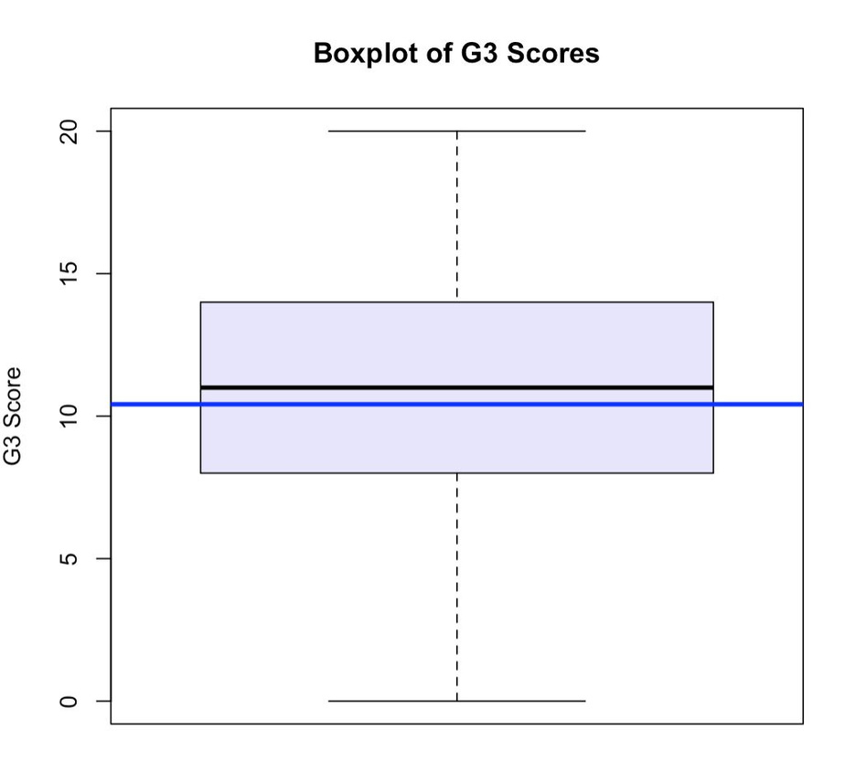
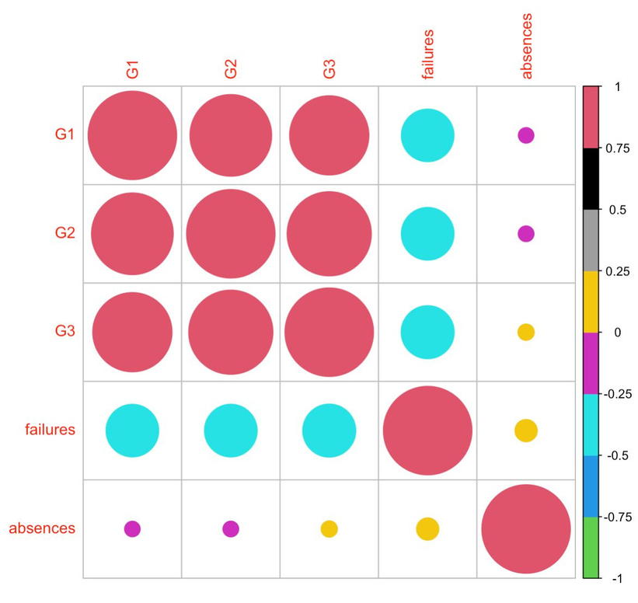
EDA
BOXPLOT OF FINAL VOTE SCORES
HEATMAP -STUDY OF CORRELATION
20
G1
G2
G3
FAIURE
ABSENCES
G1
15
G2
FINAL VOTE SCORE
10
G3
5
FAILURE
0
ABSENCES

Slide 6

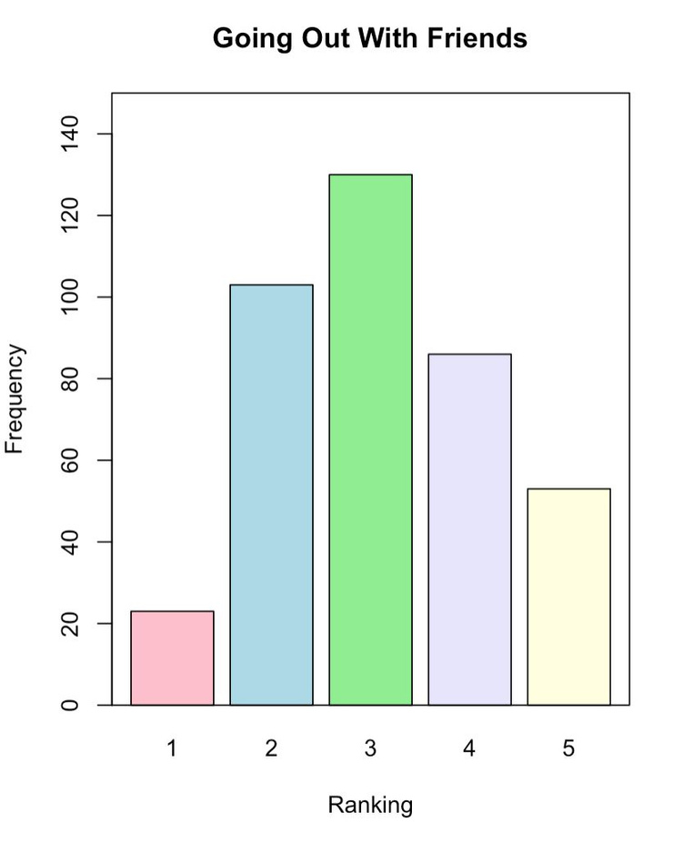
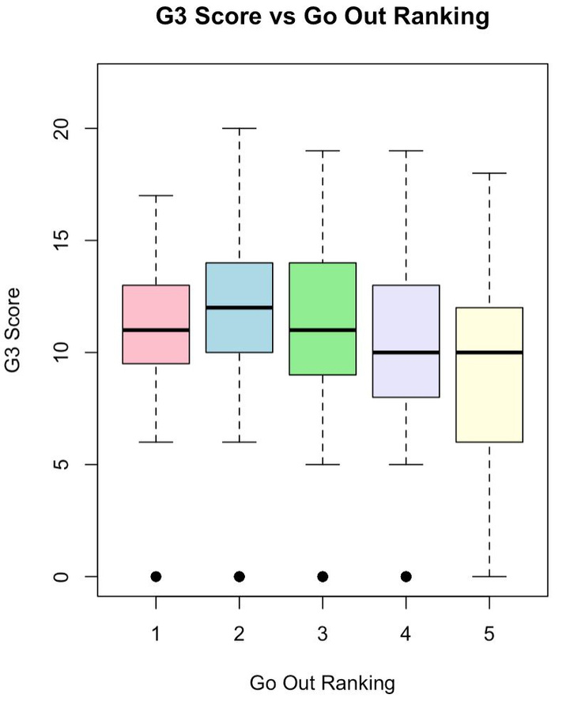
EDA
GOING OUT WITH FRIENDS
G3 SCORE VS GO OUT RANKING
140
20
120
100
15
80
FREQUENCY
FINAL VOTE
10
60
40
5
20
0
0
1
2
3
4
5
1
2
3
4
5
RANKING
GO OUT RANKING

Slide 7

GO DEEP IN THE
4 CATEGORIES

Slide 8






INDIVIDUAL ASPECTS
THE VARIABLES
The variables describe individual aspects of students including gender, age, desire to continue with their studies and so on.
Gender
Age
Higher
Traveltime
Studytime
Reason

Slide 9
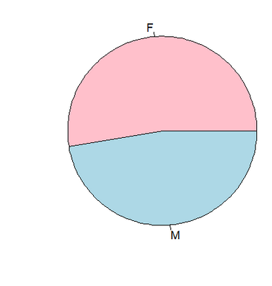
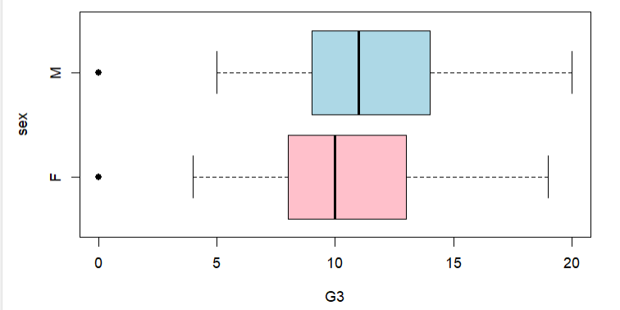
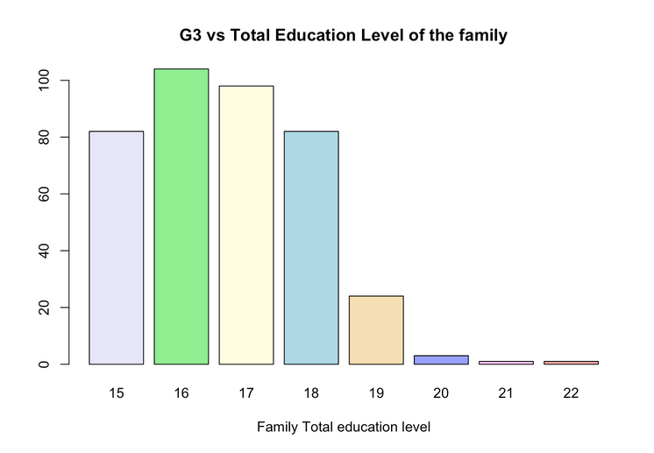
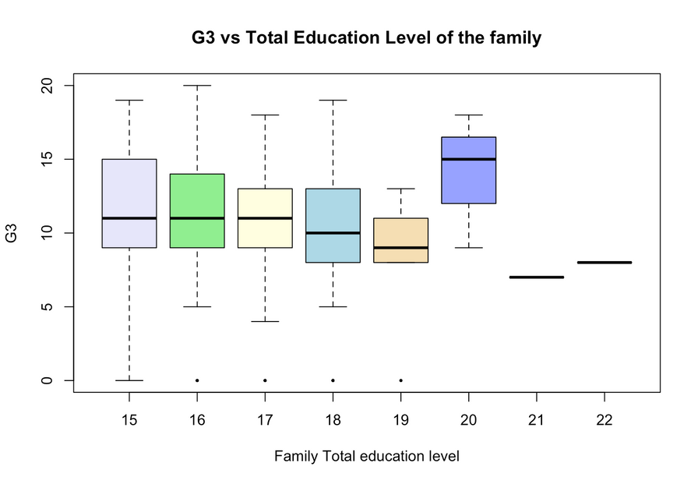
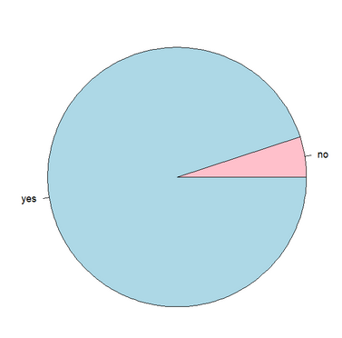
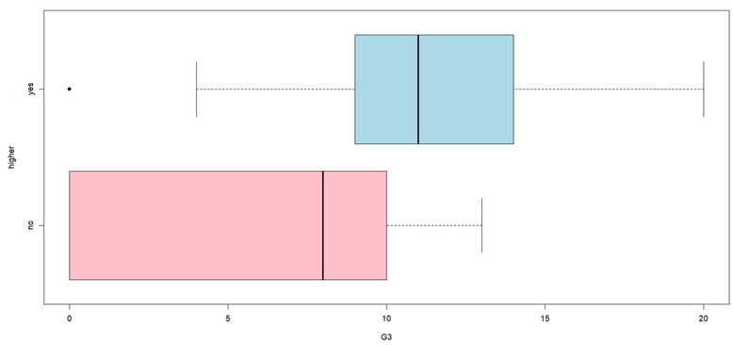
F
Gender
M
SEX
F
M
0
5
10
15
20
FINAL VOTE
100
20
Age
80
60
15
FREQUENCY
40
FINAL VOTE
10
20
0
15
16
17
18
19
20
21
22
5
AGE
0
15
15
16
16
17
18
19
20
21
22
17
18
19
20
21
22
AGE
Higher
Yes
NO
YES
HIGHER
No
0
5
10
15
20
FINAL VOTE

Slide 10
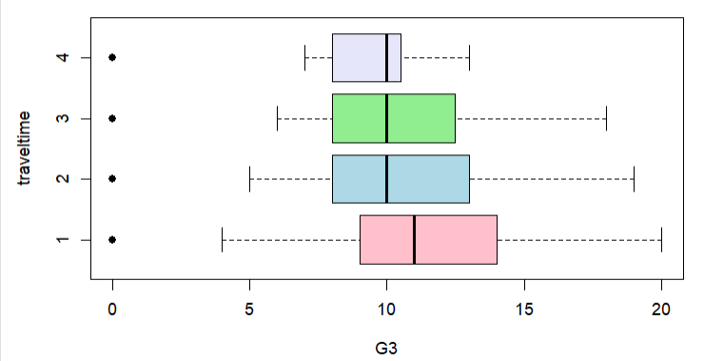
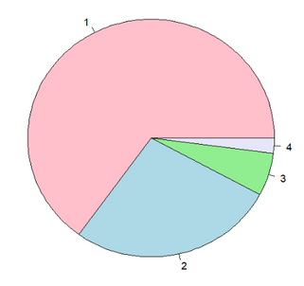
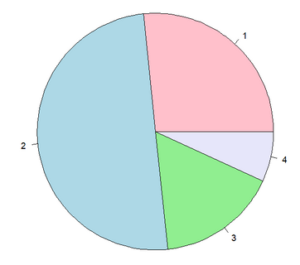
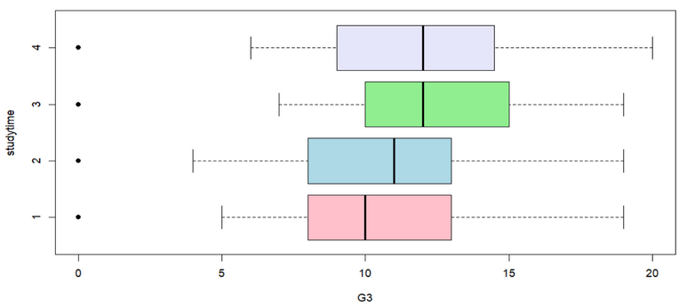
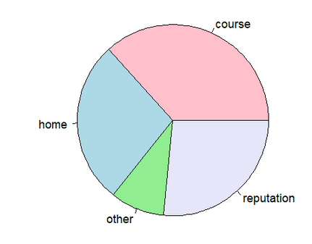
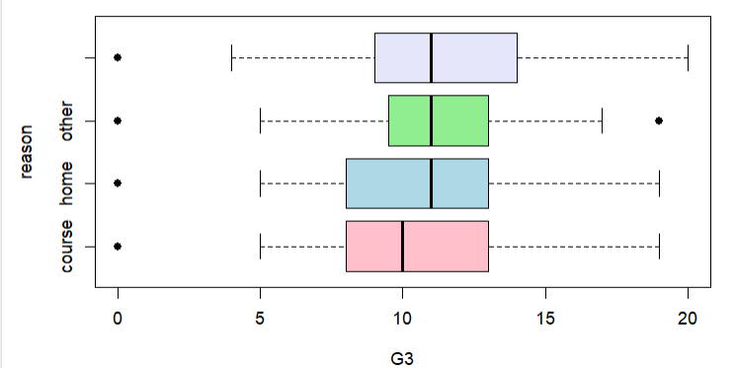
1
4
3
TRAVELTIME
Traveltime
2
4
3
1
2
0
5
10
15
20
FINAL VOTE
1
4
3
Studytime
STUDYTIME
2
2
4
1
3
0
5
10
15
20
20
FINAL VOTE
COURSE
REPUTATION
Reason
OTHER
REASON
HOME
HOME
COURSE
OTHER
REPUTATION
0
5
10
15
20
FINAL VOTE

Slide 11








FAMILY BACKGROUND
THE VARIABLES
The variables describe fundamental characteristics related to the family background. Family occupational status, the relationship with parents, family structure, and other factors related to the family unit are considered.
MJOB
FAMSIZE
MEDU/FEDU
FAMSUP
FJOB
INTERNET
FAMREL
ADDRESS

Slide 12

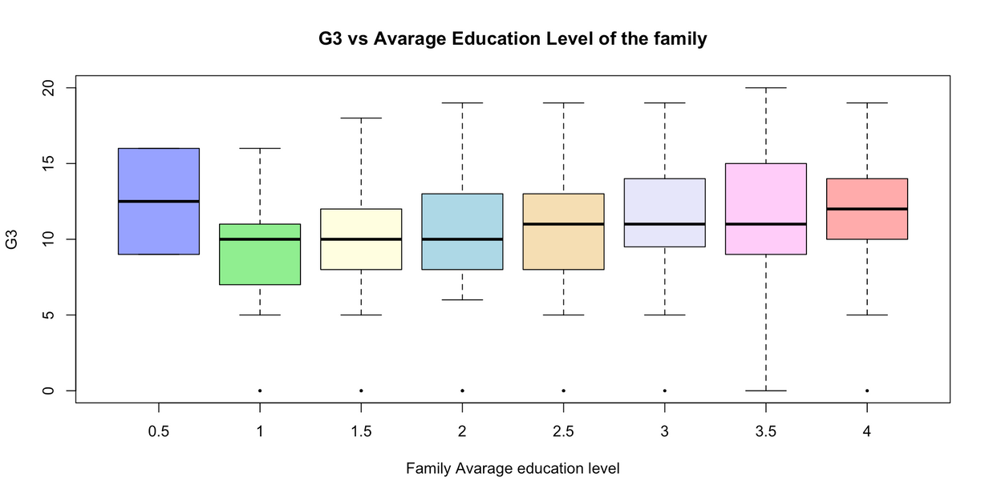
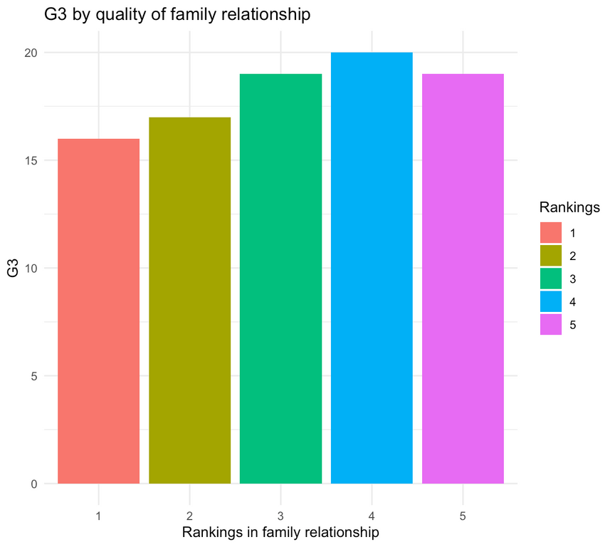
FINAL VOTE VS EDUCATION LEVEL OF THE FAMILY
20
15
10
FINAL VOTE BY QUALITY OF FAMILY RELATIONSHIP
FINAL VOTE
5
0
0.5
1
1.5
2
2.5
3
3.5
4
FAMILY AVERAGE EDUCATION LEVEL
FINAL VOTE
RANKING IN FAMILY RELATIONSHIP

Slide 13
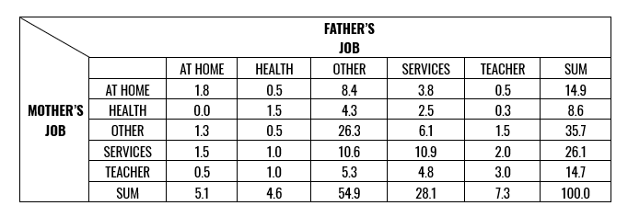
IN DEPTH WITH PARENTS’ JOB

Slide 14
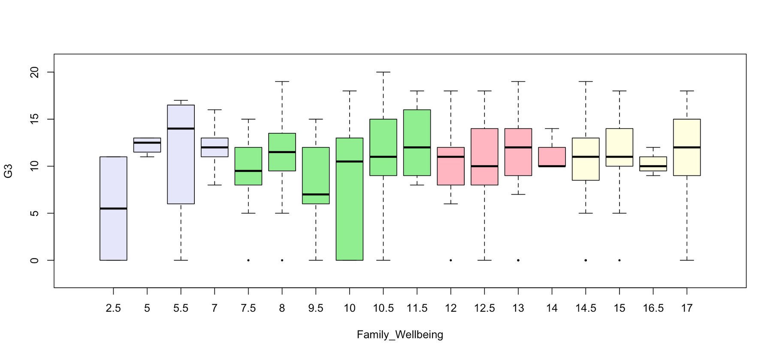
FAMILY BACKGROUND
FAMILY WELLBEING
The "family wellbeing" indicator provides an overall framework for the quality of family life, helping to assess how a student's life in a safe and supportive environment influences their overall performance
20
15
FINAL VOTE
10
5
0
2.5
5
5.5
7
7.5
8
9.5
10
10.5
11.5
12
12.5
13
14
14.5
15
16.5
17
FAMILY WELLBEING

Slide 15





SOCIAL ASPECTS
THE VARIABLES
The variables describe student attributes in relation to social behaviors, including
categorical, ordered variables of the students’ free time and how often they spend time with friends, alcohol consumption, and relationship status.
S-S
ROMANTIC
GOOUT
WALC
M-F
FREETIME
DALC

Slide 16
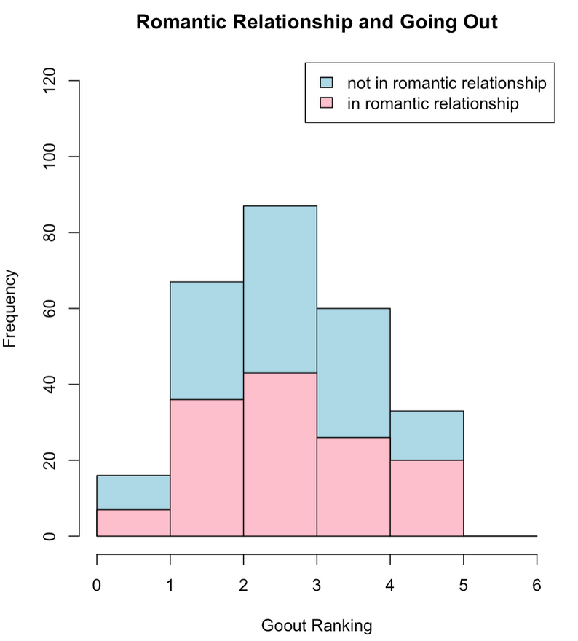
SOCIAL ASPECTS
Romantic Relationship and Going Out with Friends
Wilcoxon rank sum exact test
data: goout_romantic_no and go_out_romantic_yes
W=19, pvalue=0.222

Slide 17
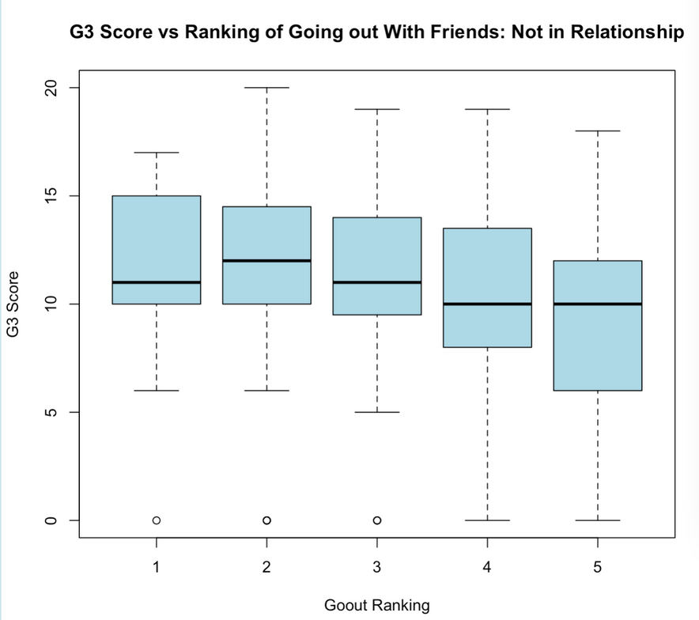
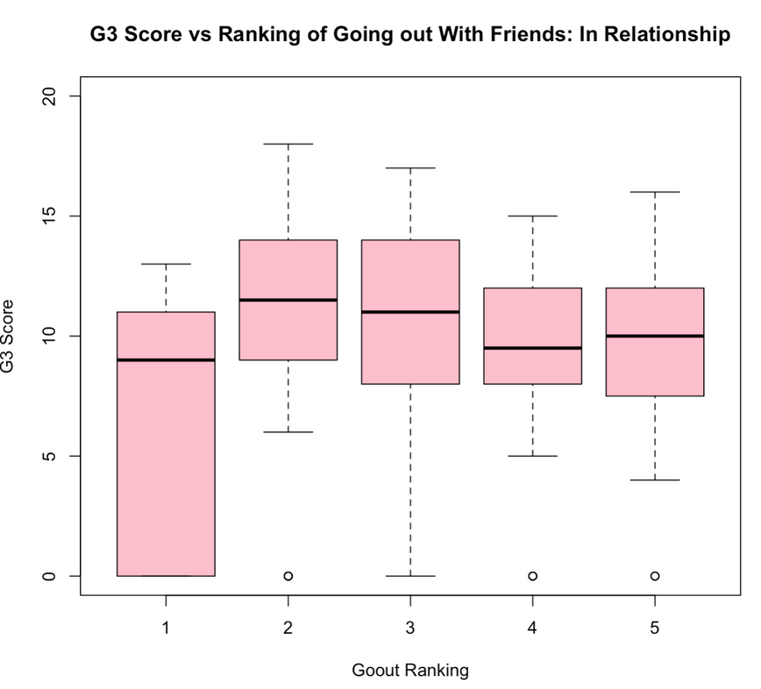
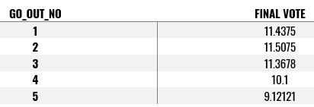
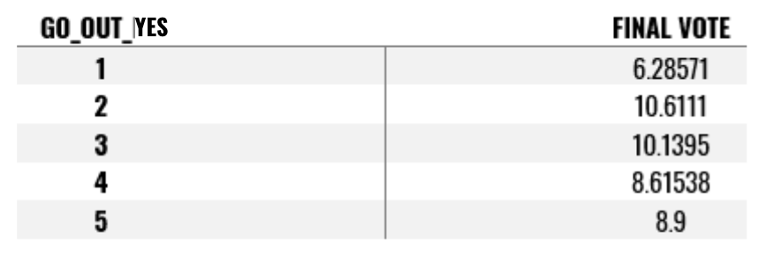
G3 score vs Ranking of going out with friends: not in relationships
G3 score vs Ranking of going out with friends: in relationships
FINAL VOTE
FINAL VOTE
1
2
3
4
5
1
2
3
4
5
GO OUT RANKING
GO OUT RANKING

Slide 18








SCHOOL ASPECTS
The variables describe the school aspects, it contains a detailed description of the individual education from the school attended to past failures, the educational context and reflects challenges and personal growth, extra-activities and educational support shows commitment and passion.
SCHOOL
FAILURES
SCHOOLSUP
PAID
ACTIVITIES
NURSERY
G1, G2
G3

Slide 19
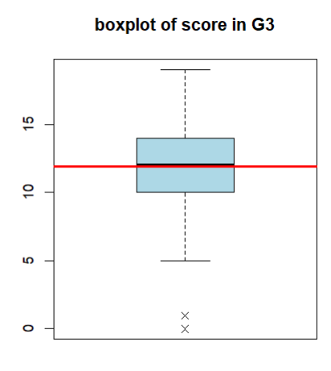
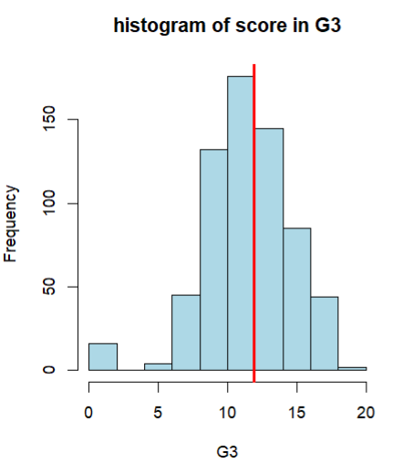
SCHOOL ASPECTS
Boxplot of score in final vote
Histogram of score in final vote

Slide 20
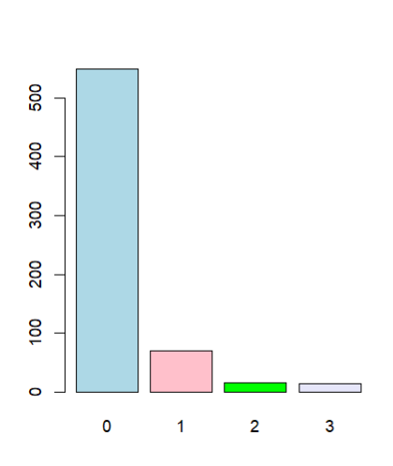
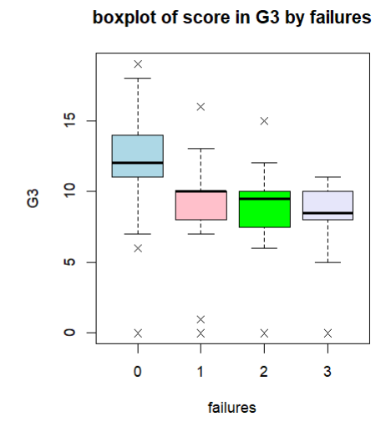
Boxplot of score in final vote by failure
Final vote
Failure

Slide 21
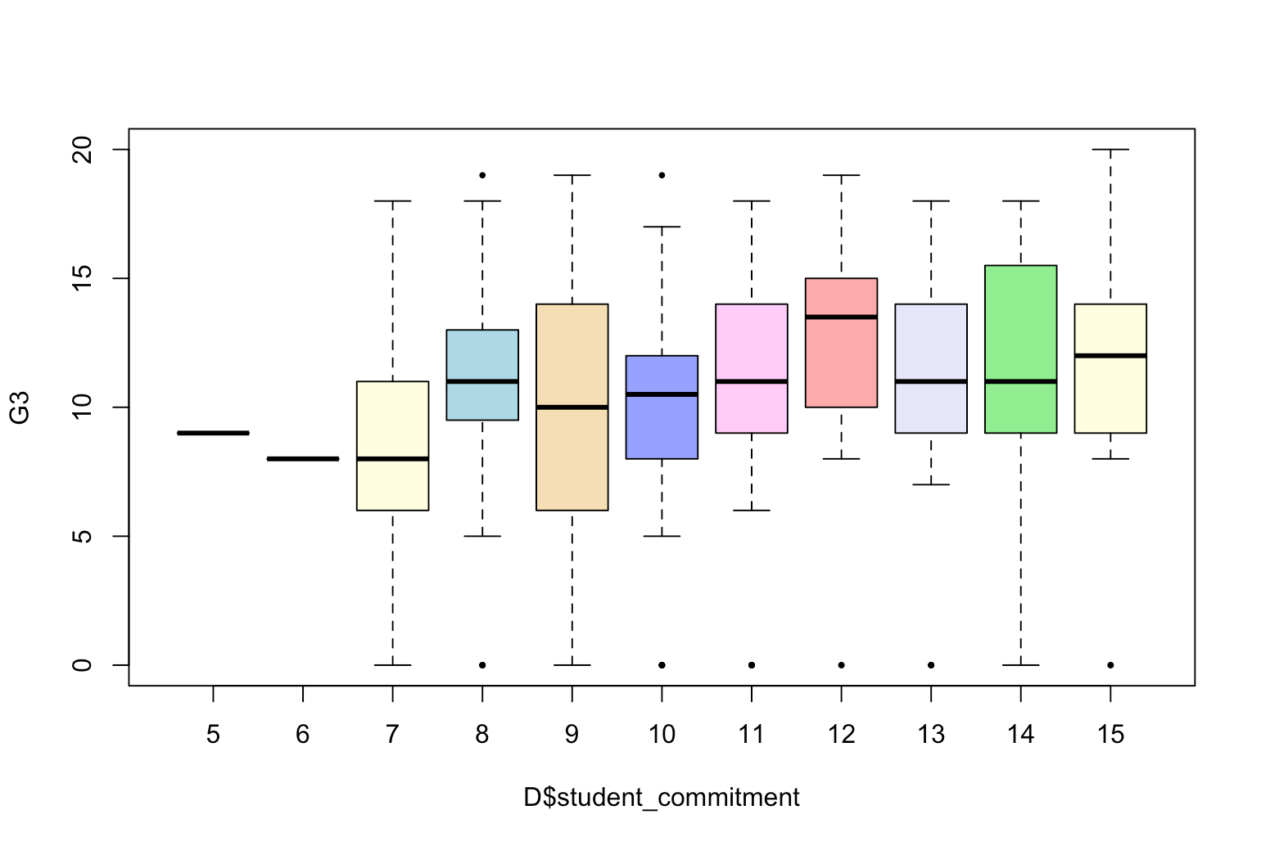
SCHOOL ASPECTS
STUDENT COMMITMENT
The student commitment is the dedication that the student invests in their academic career, and combines factors such as study time and extracurricular activities.
20
15
10
FINAL VOTE
5
0
5
6
7
8
9
10
11
12
13
14
15
STUDENT COMMITMENT

Slide 22
MODEL
FINAL VOTE = 5.46 + 0.46 FAMILY_EDU + 0.24 STUDENT_COMMITMENT
ESTIMATE
STD.ERROR
T VALUE
P VALUE
INTERCEPT
5.4622
1.3399
4.077
<0.05
FAMILY_EDU
0.4609
0.1148
4.014
<0.05
STUDENT_COMMITMENT
0.2421
0.1169
2.071
0.039

Slide 23




SUGGESTIONS
Family suggestion
School suggestion
Incorporating tutoring and extracurricular activities, whether paid or unpaid, significantly enhances students' academic performance. Strategically increasing these opportunities can yield substantial improvements in student outcomes.
Strong parental involvement fosters a conductive learning environment, where parental education and occupation act as cornerstones for educational aspirations.

Slide 24
THANKS FOR YOUR ATTENTION

